Slide 1
Inovações em transplante de fígado – O impacto para o patologista
John Hart, MD
Universidade de Chicago, EUA

Slide 2
Declaração de Conflito de Interesse
Dr Hart não ter conflito de interesse a declarar
Em caso afirmativo, especificar: associação financeira relevante
nos últimos 12 meses e que esteja relacionada ao conteúdo da
atividade científica
Exigência da RDC Nº 96/08 da ANVISA

Slide 3
Expanding the Donor Pool
Use of living donors
Use of HCV positive donor organs
Use of steatotic donor organs
Use of donor organs harvested after circulatory death (DCD)
Use of ABO incompatible donor organs
Normothermic machine perfusion of donor organs

Slide 5
Notes:
change of biloma, cholangitis lenta

Slide 6
Center Name | Living Donor Liver Transplants in 2021 | Living Donor Liver Transplants in 2022
University of Pittsburgh Medical Center | 72 | 76
University Hospital, University of TX Health Sciences Center | 46 | 49
Cleveland Clinic | 33 | 29
University of California San Francisco Medical Center | 24 | 26
University of Washington Medical Center | 12 | 25
Keck Hospital of USC | 26 | 24
Johns Hopkins Hospital | 19 | 22
VCU Health Systems Authority, VCU Medical Center | 19 | 21
New York Presbyterian Hospital/Columbia University Medical Center | 13 | 18
Lahey Clinic Medical Center | 18 | 17
Baylor University Medical Center | 10 | 15
University of Colorado Hospital/Health Science Center | 10 | 15
Hospital of the University of Pennsylvania | 16 | 14
University of Chicago Medical Center | 9 | 14
Intermountain Medical Center | 7 | 13

Slide 7
Notes:
Just adults!!! Patient and graft survival better; less ACR

Slide 11
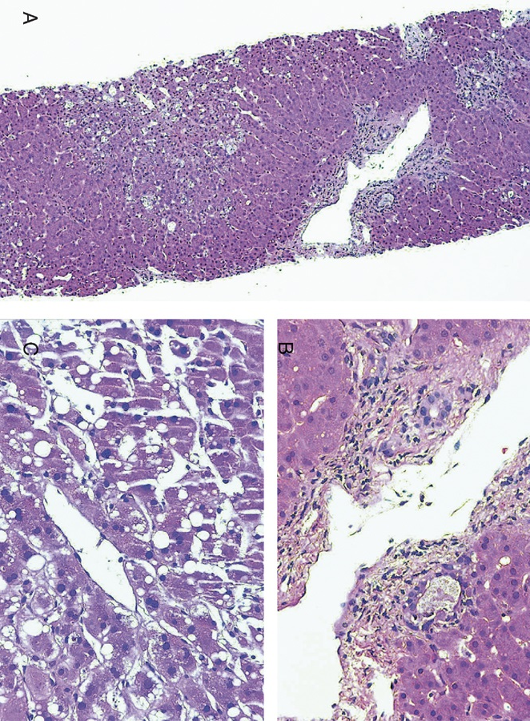
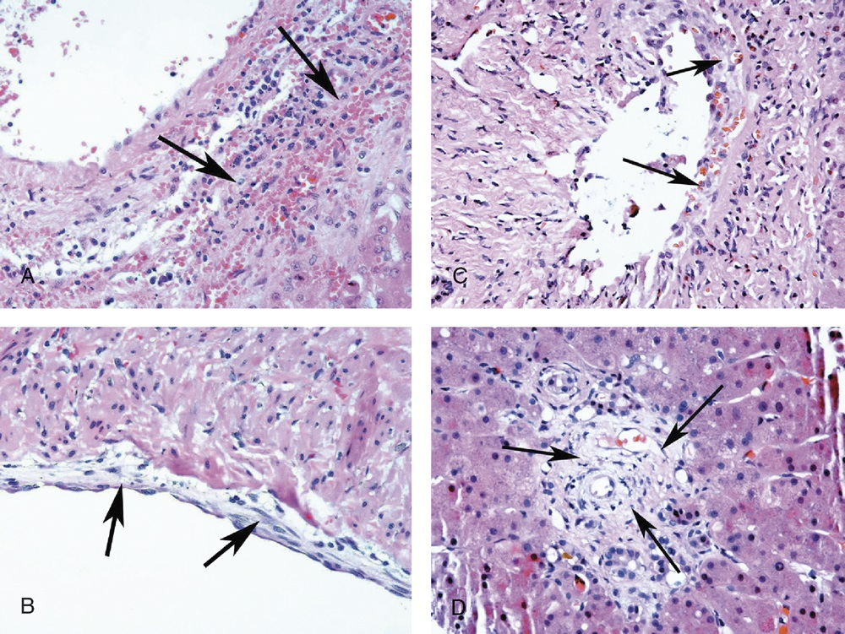

Slide 12
Slide Title

Slide 14
Frozen Section Evaluation of HCV Positive Donor Biopsies:
Use standard grading and staging scheme (e.g., Batts & Ludwig):
    Degree of necroinflammatory activity
Degree of fibrosis
Stage more important than grade
Presence of steatosis/steatohepatitis may influence suitability of the organ more than the HCV infection

Slide 15
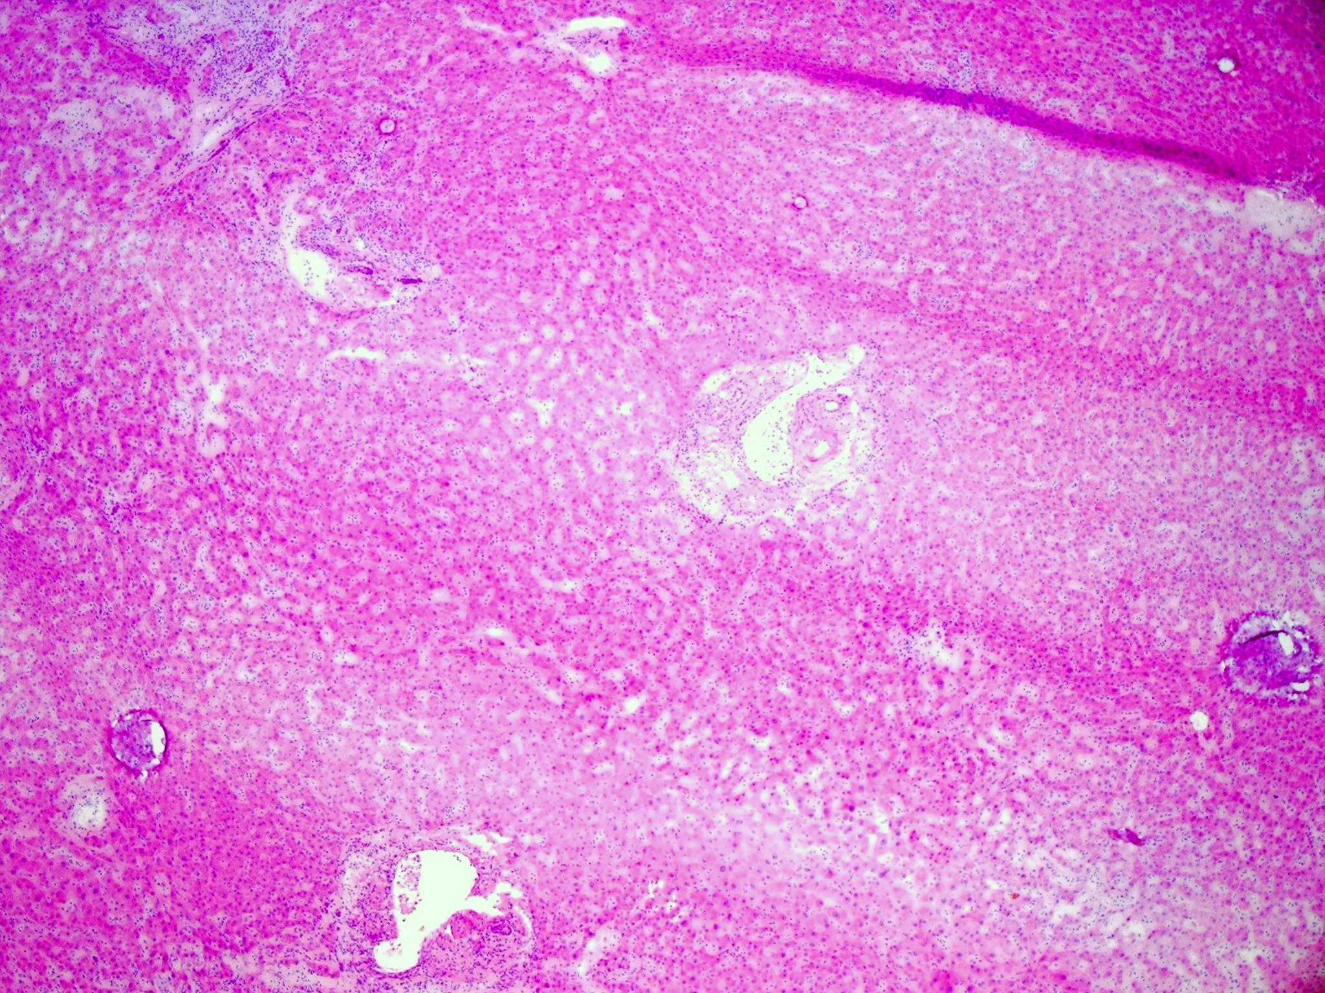
Chronic HCV hepatitis – Grade 1, stage 1

Slide 16
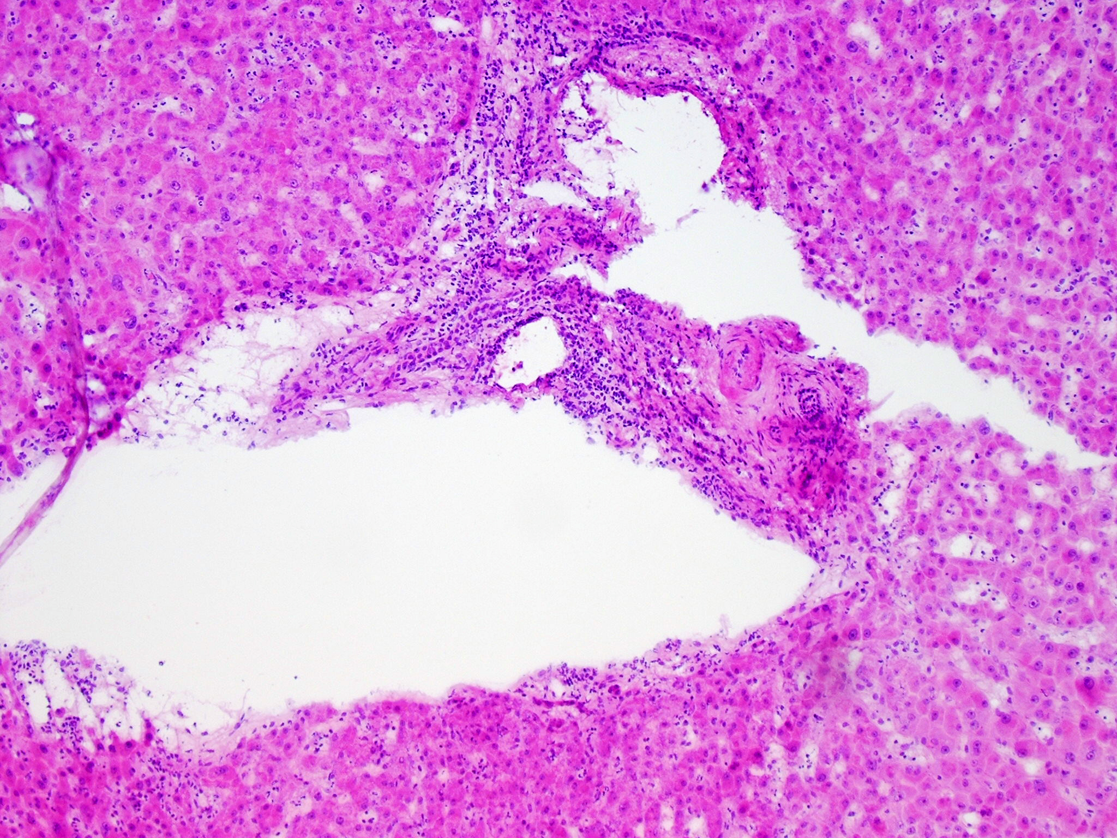

Slide 17
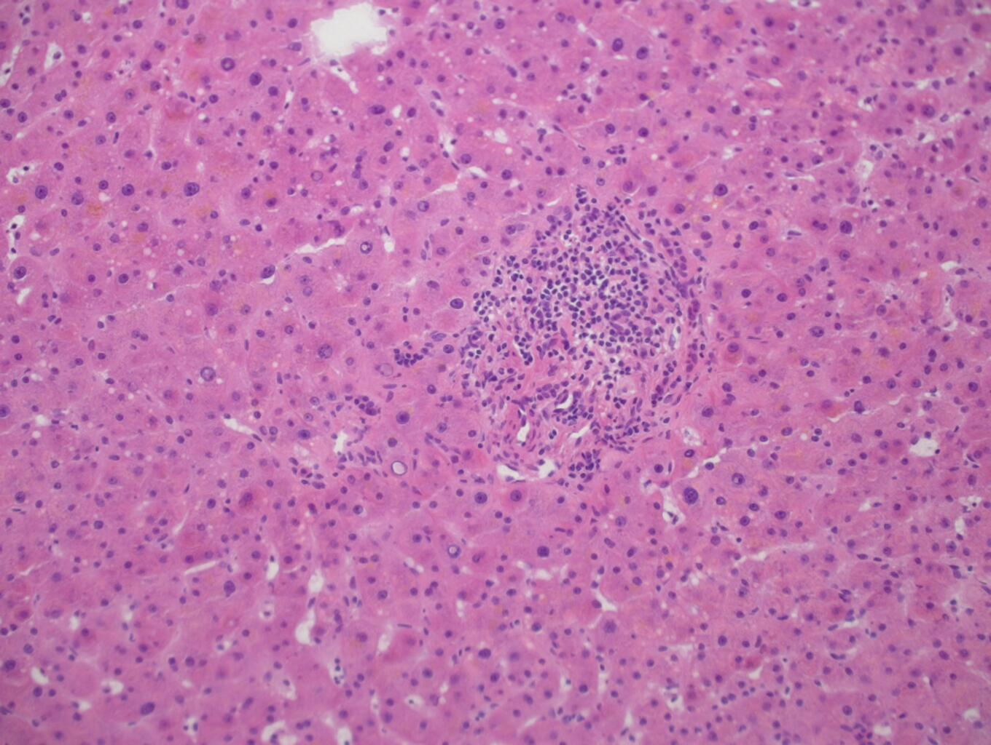
Mild non-specific portal inflammation can be ignored

Slide 18
Typical histologic features of chronic HCV are often still present following SVR in liver transplant patients
In the first post-SVR biopsy, grade often goes down, but changes in stage are more variable
In patients with increases in grade or stage in the first post-SVR biopsy, they seem to eventually regress, but this can take years
In 25% of patients with multiple post-SVR biopsies progression in grade occurred, and 25% of those have a progression in stage

Slide 19
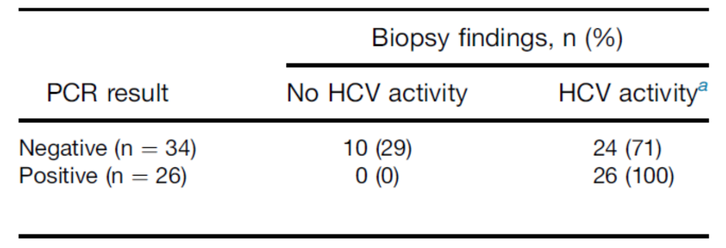

Slide 20
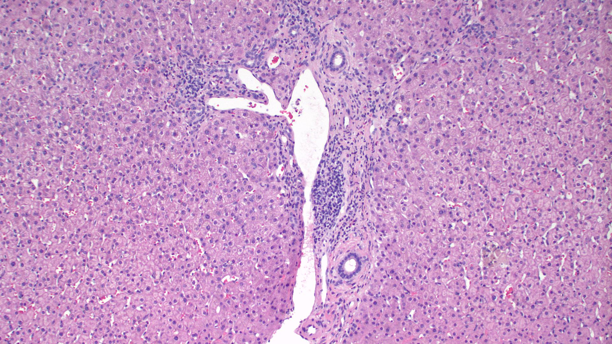
Recurrent chronic HCV hepatitis (G1, S1) after SVR

Slide 21
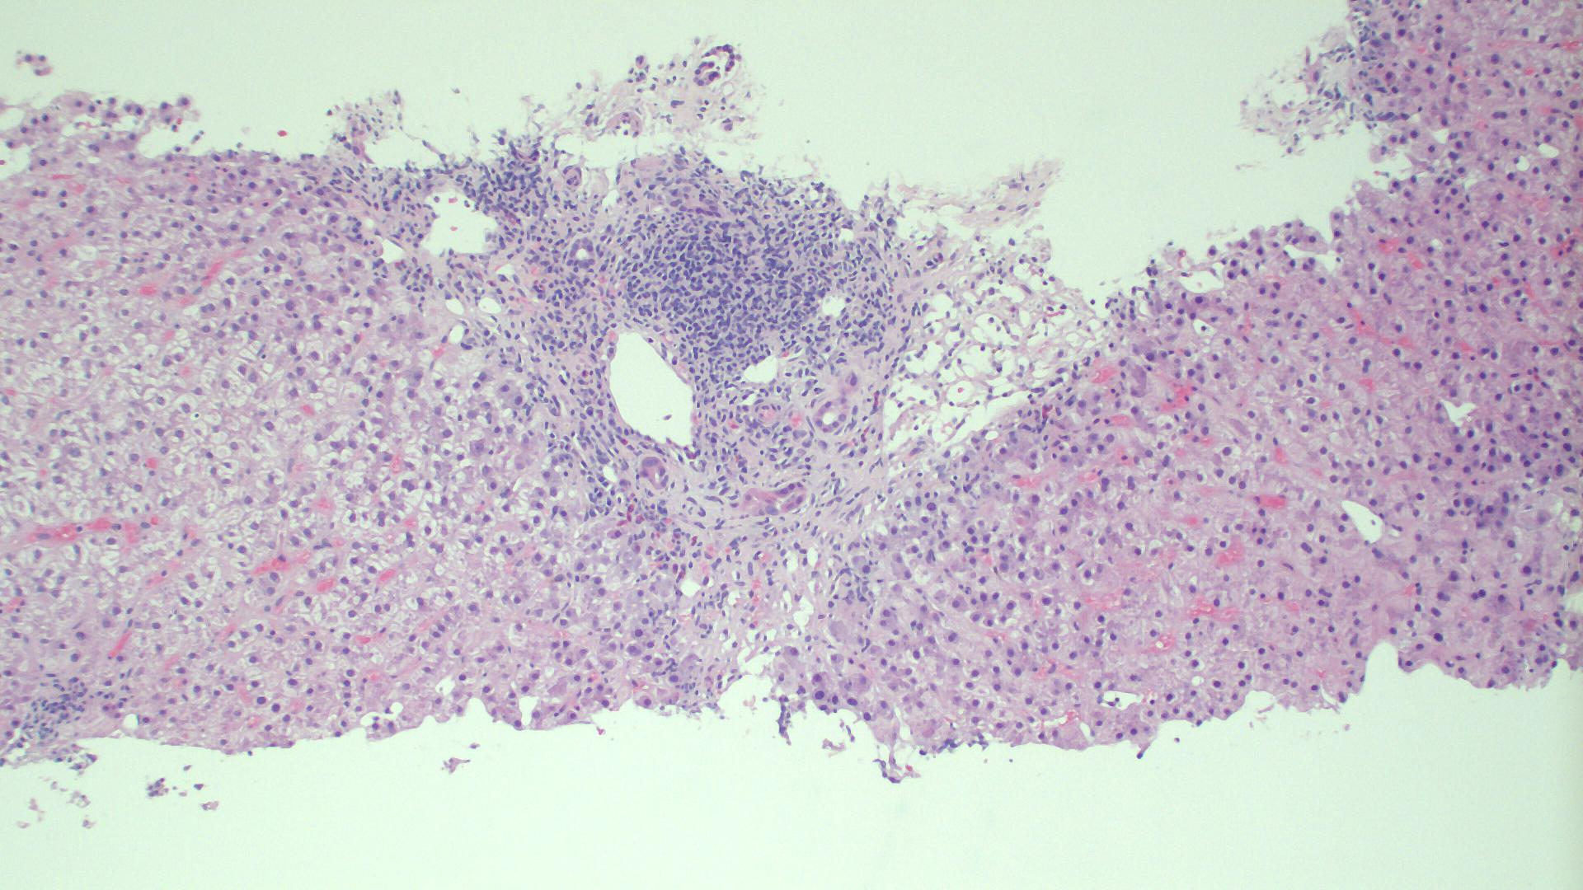
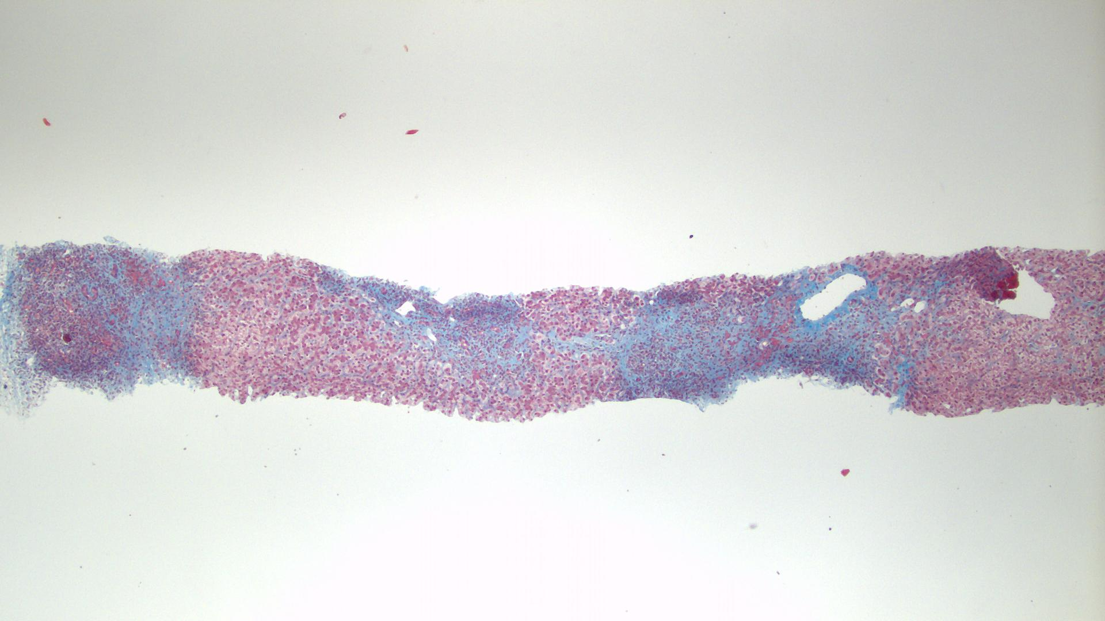
Recurrent chronic HCV hepatitis (G3, S3) after SVR

Slide 23
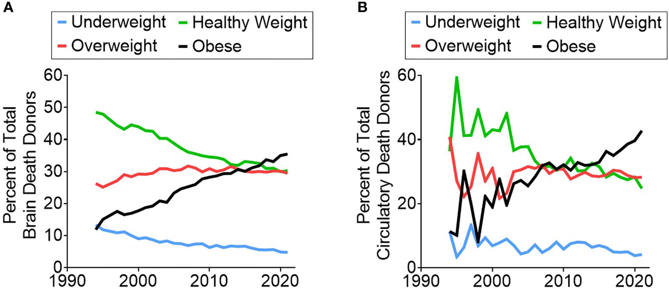

Slide 26
median MODEL FOR GRAFT FUNCTION score

Slide 29

Título

Slide 30
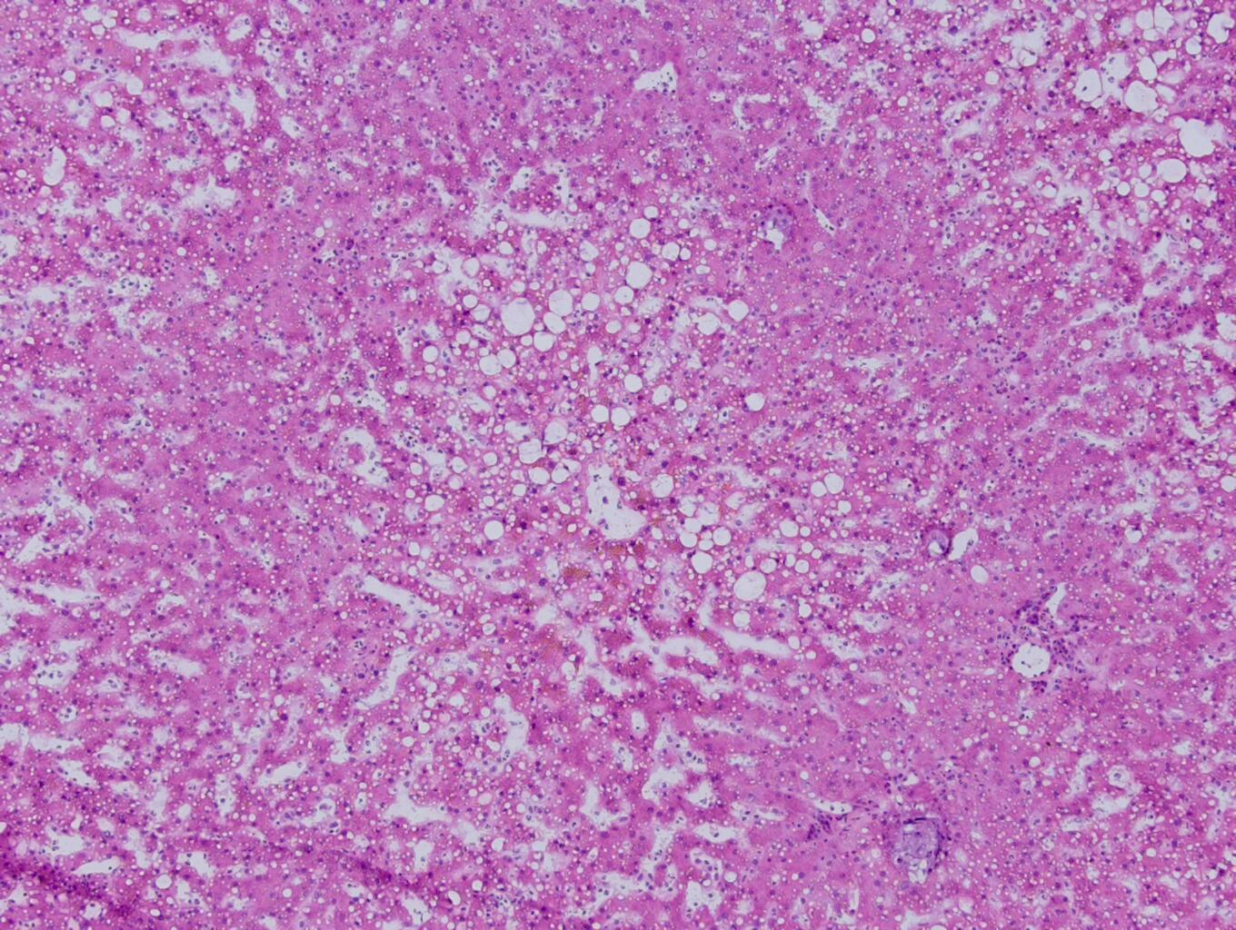
Wedge biopsy with 30% macrovesicular steatosis
Mild microvesicular steatosis also present (don’t report)

Slide 31
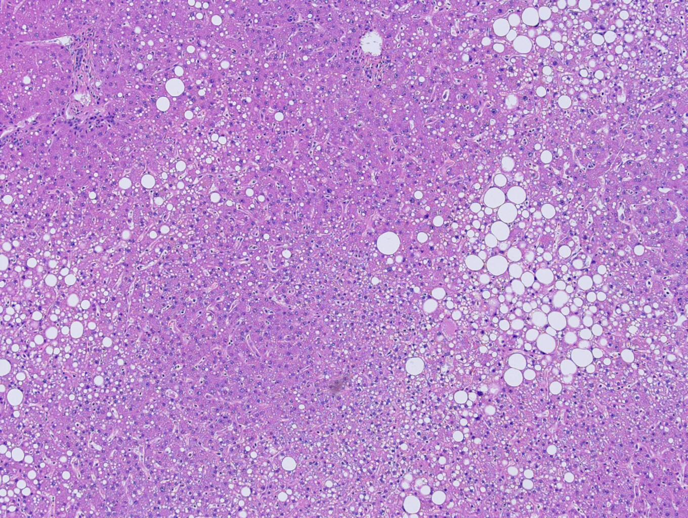
Permanent section 20% macrovesicular steatosis
Excellent post-transplant graft function

Slide 32
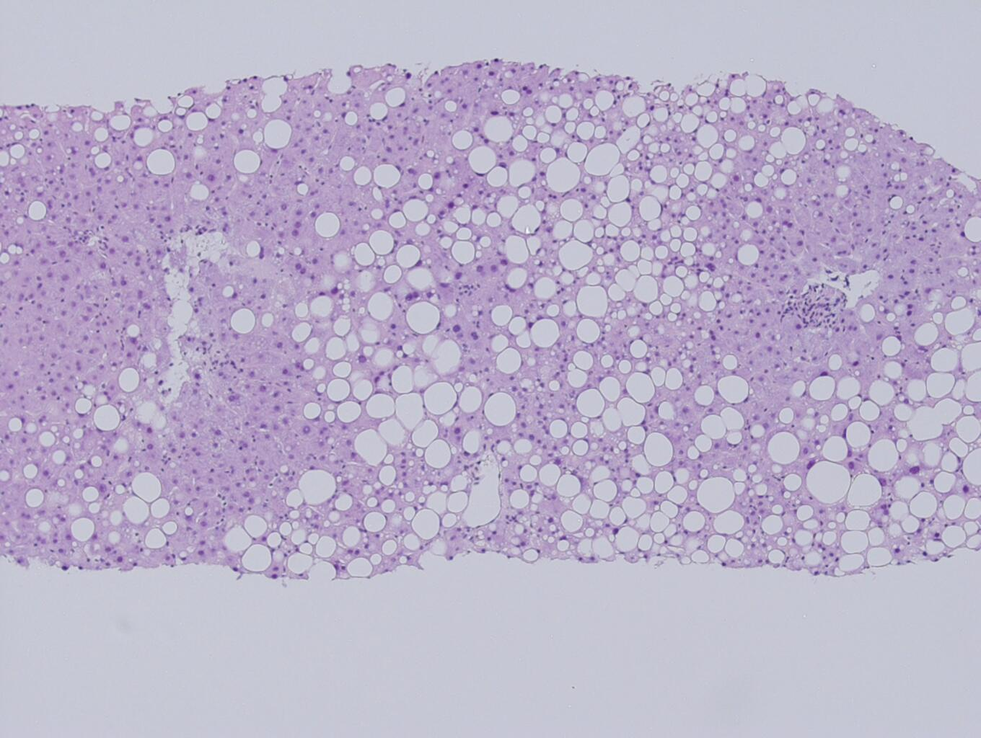
40-50% macrovesicular steatosis
Postoperative graft function was excellent
Percent
Steatosis?

Slide 33
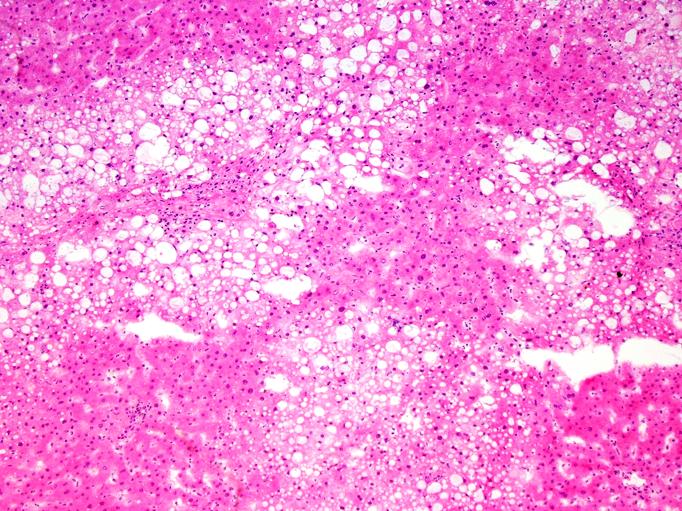
50% macrovesicular steatosis
Postoperative graft function was excellent

Slide 35
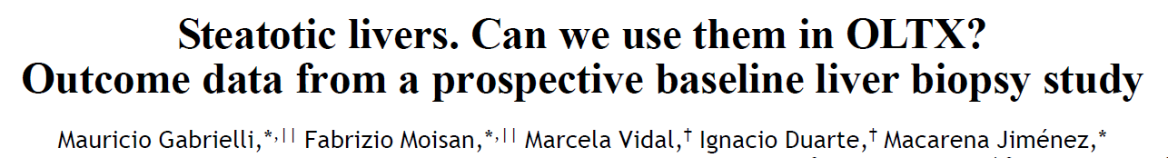
Ann Hepatol 2012; 11: 891-98.
Patient Survival
( < 6%)
(6 to 66%)
( >66%)

Slide 36
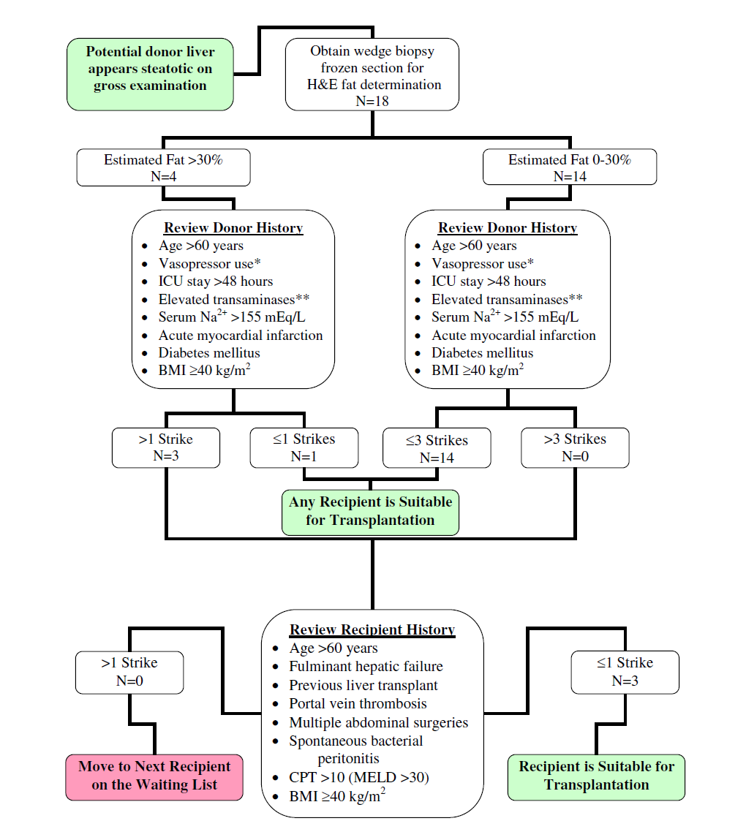
Chavin KD et al. Clin Transplant 2013: 27: 732–41.

Slide 37
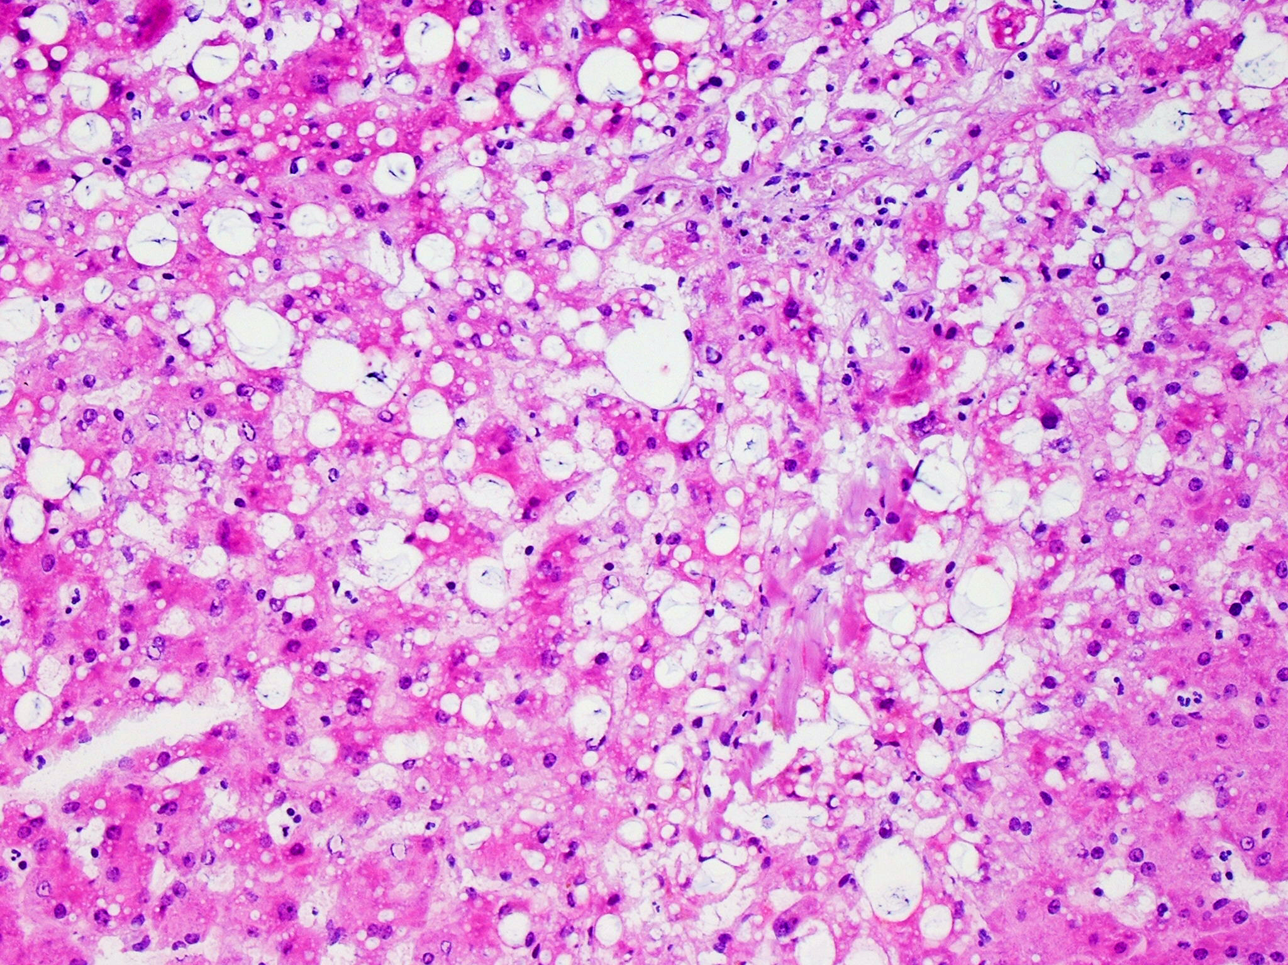
NASH

Slide 38
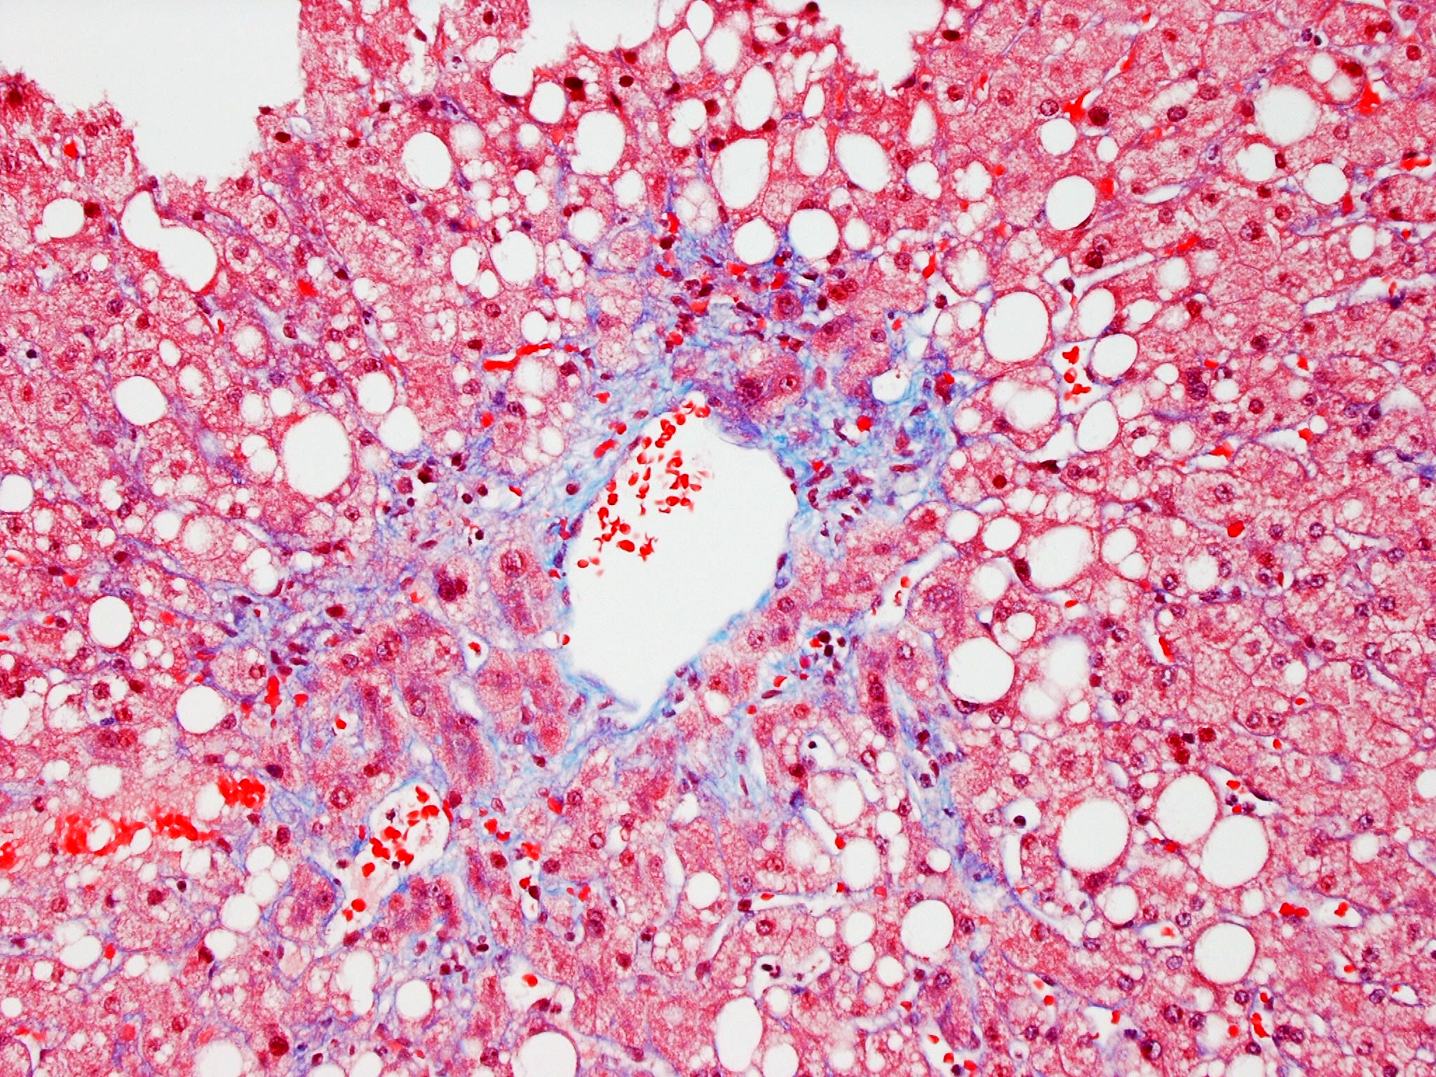
NASH – trichrome on permanent section

Slide 39
Donation after Circulatory Death (DCD)
Formally known as donation after cardiac death
Waiting period to declaration of death (warm ischemia time)
Additional risk of ischemic donor graft injury during agonal period and death declaration
Stringent donor selection criteria: limits on donor age, donor body mass index, and ischemic time
Specific recipient criteria - high risk recipients
Machine perfusion techniques to decrease graft injury
Increased risk of ischemic biliary complications

Slide 40
Slide Title

Slide 41
Slide Title

Slide 45
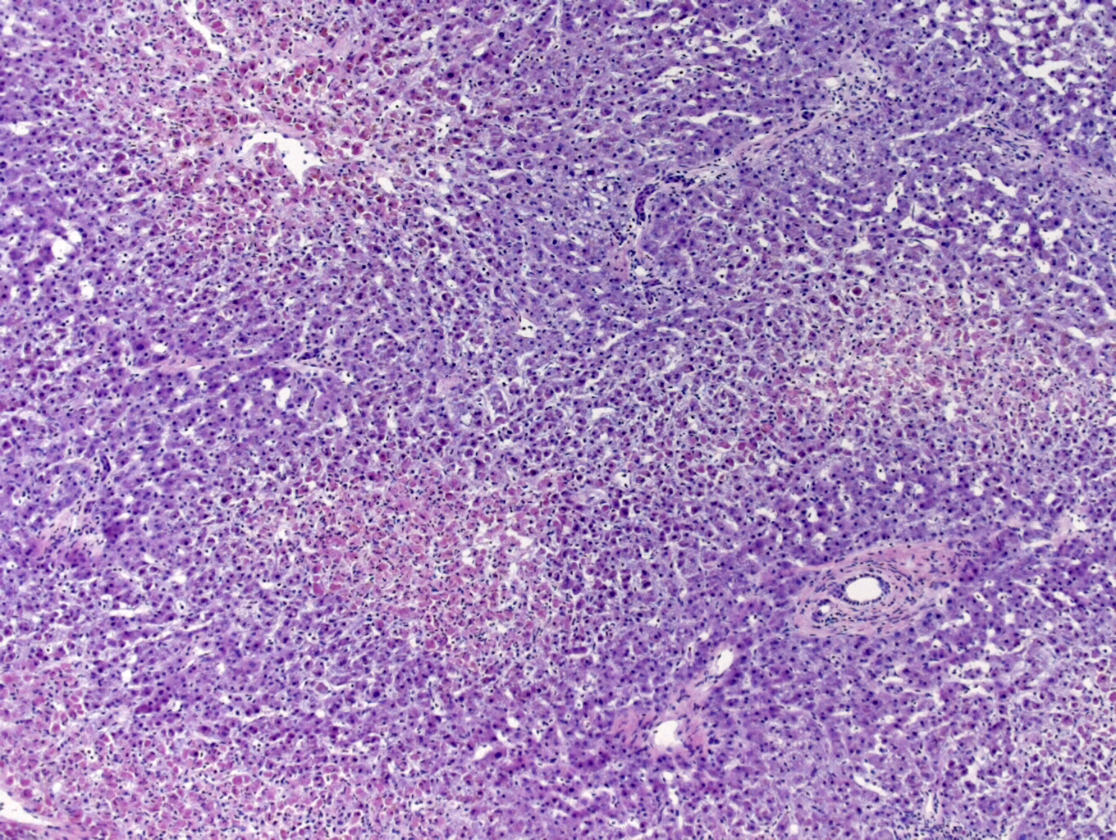
Donation after circulatory death
AST and ALT rising prior to declaration of death

Slide 46
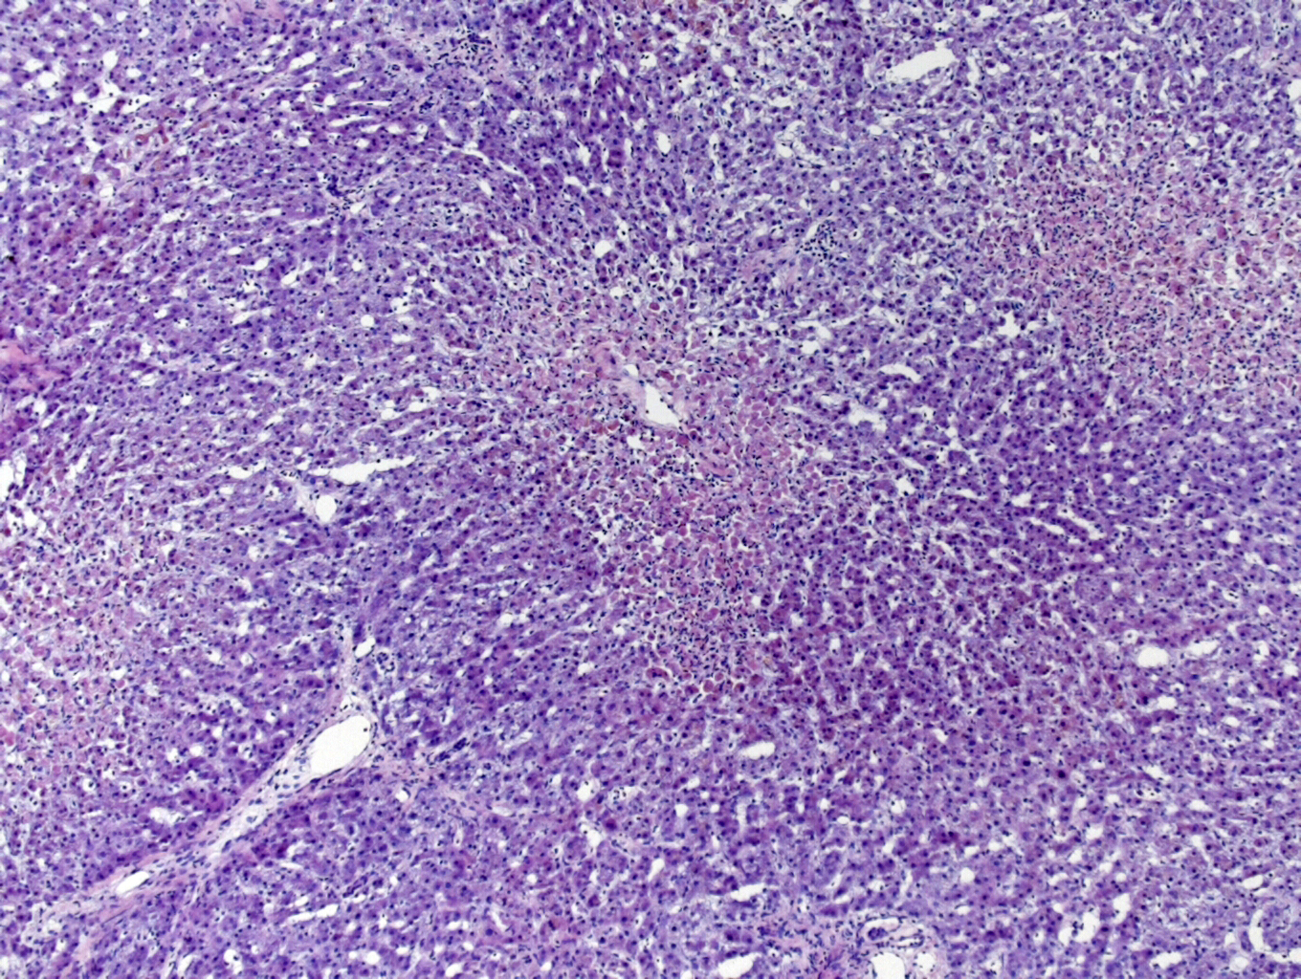

Slide 47
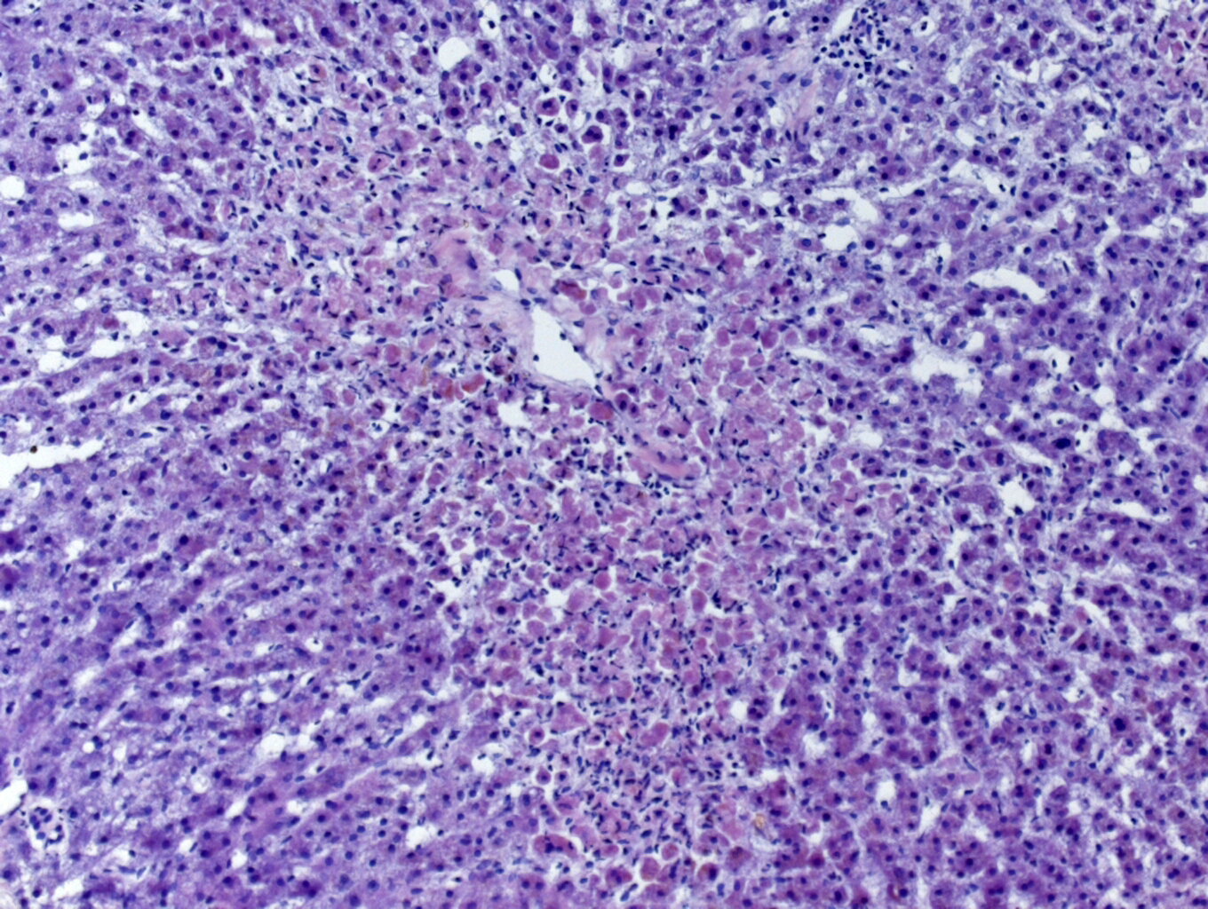

Slide 48
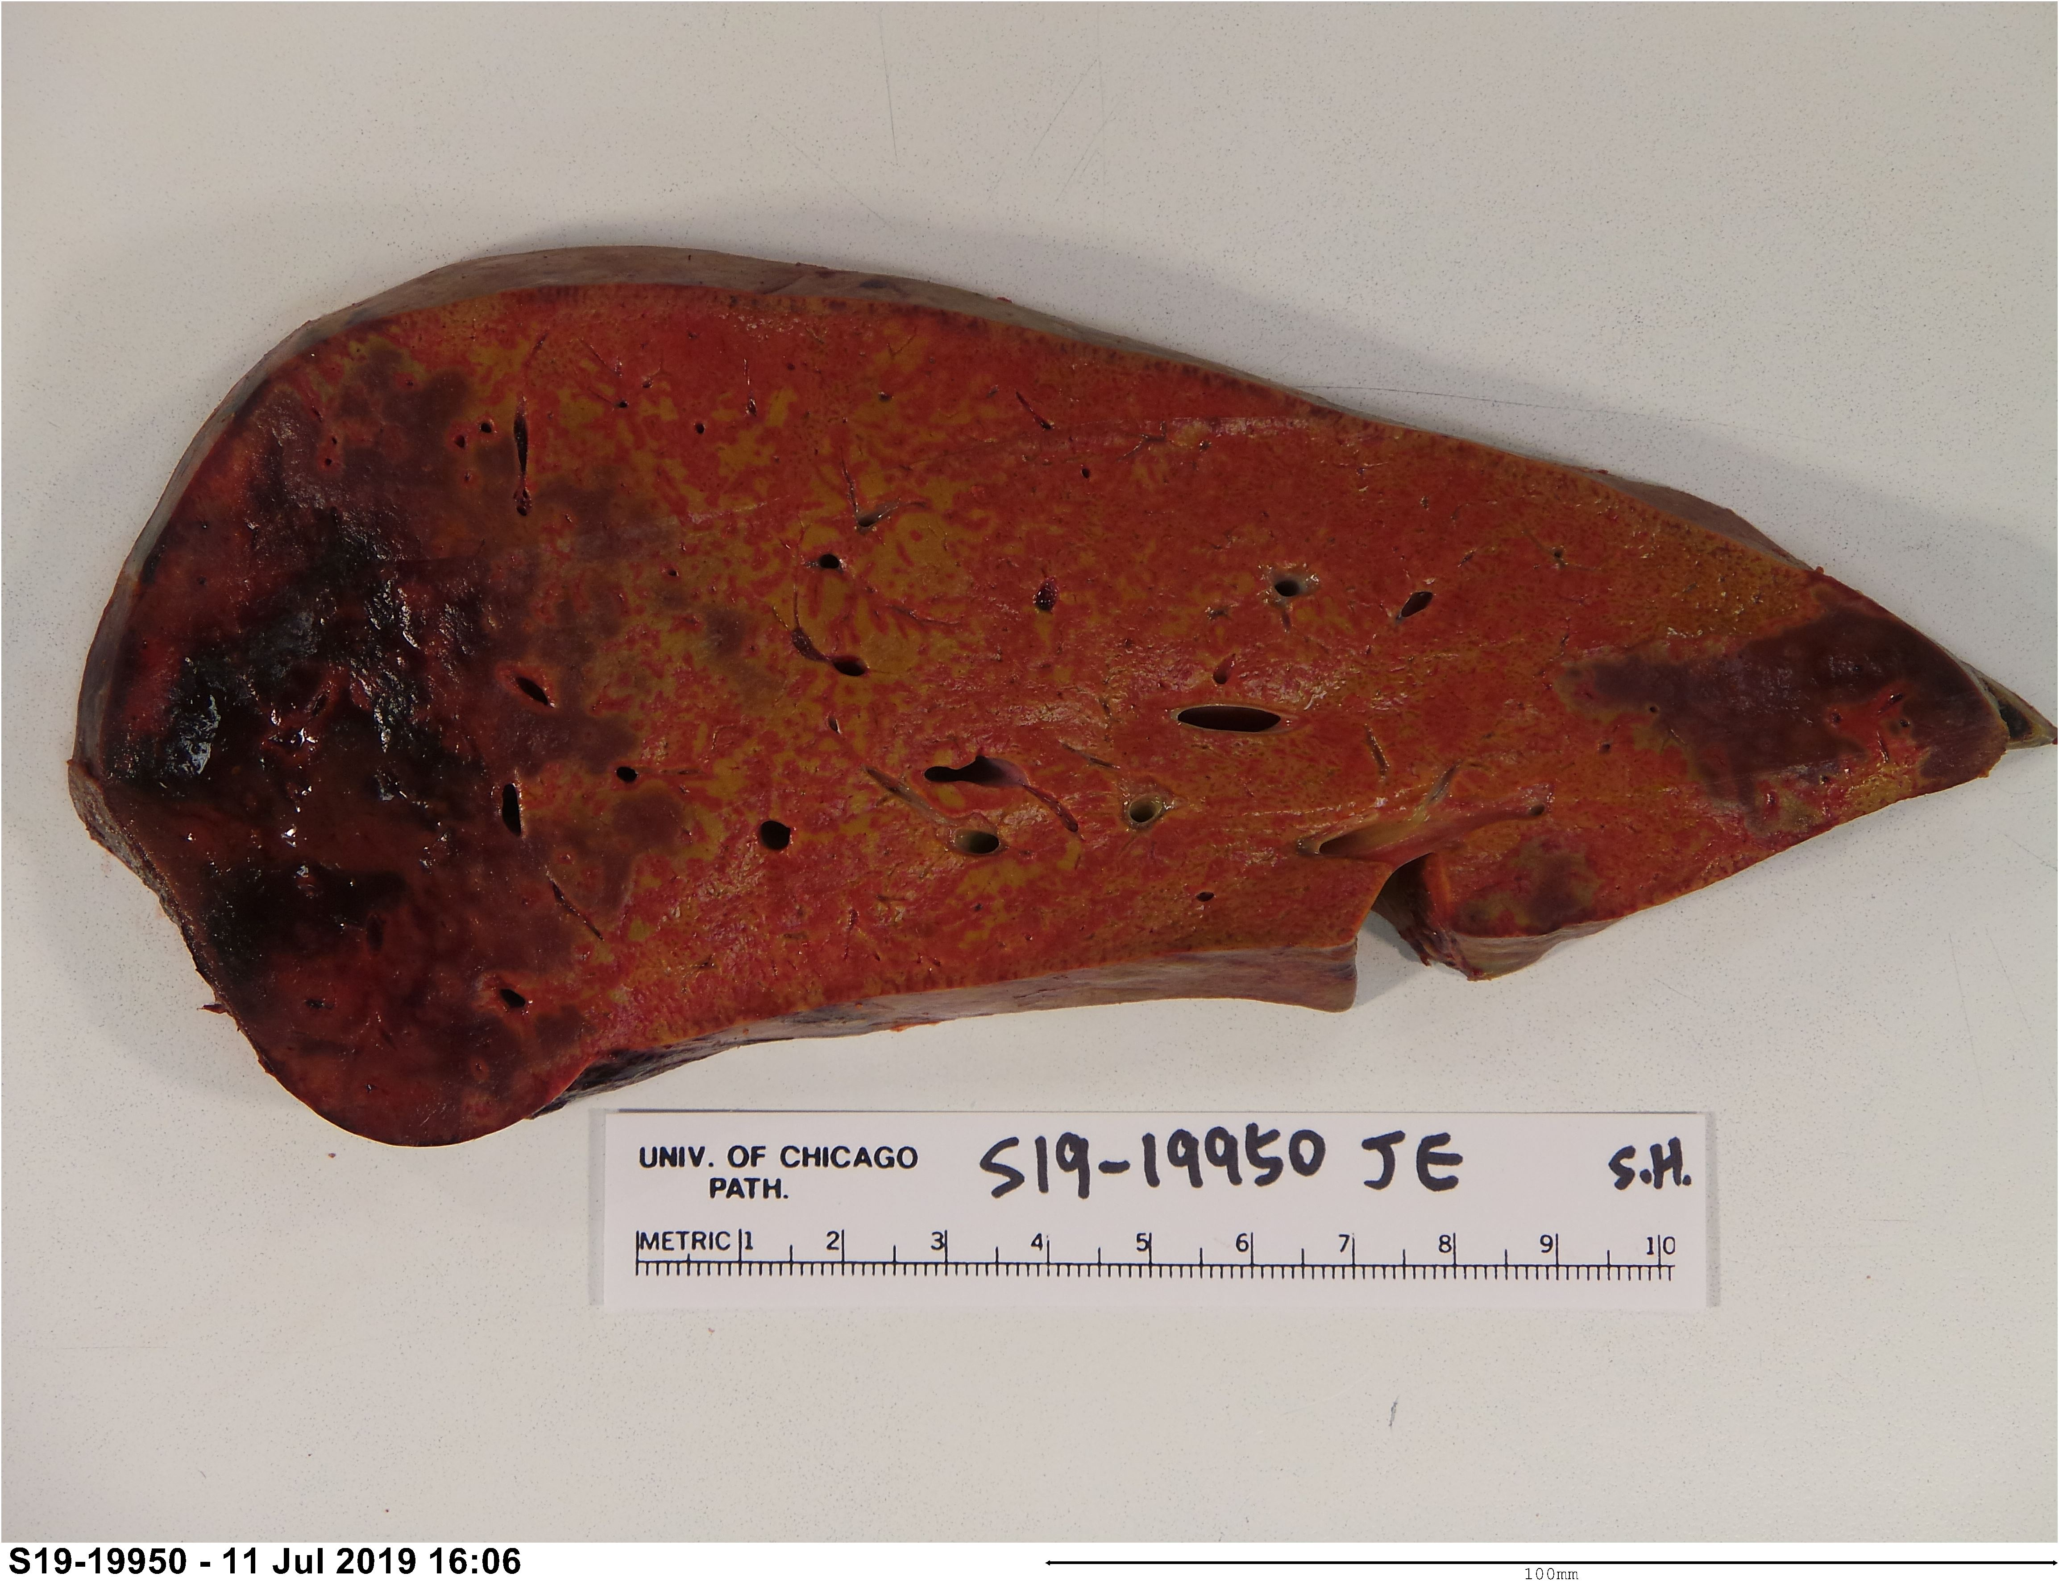
Allograft failed and was replaced on POD 4

Slide 50
Clinical History
58 year old M with cirrhosis due to chronic HCV hepatitis
Underwent successful TARE of 3 HCCs
Now undergoes liver transplant – donor liver obtained after circulatory death (DCD)
Rising serum TB and alk phos one year after transplant
Imaging reveals multiple intrahepatic biliary strictures in both lobes
Stenting unsuccessful (no evidence of recurrent HCC)
Re-transplantation performed

Slide 51
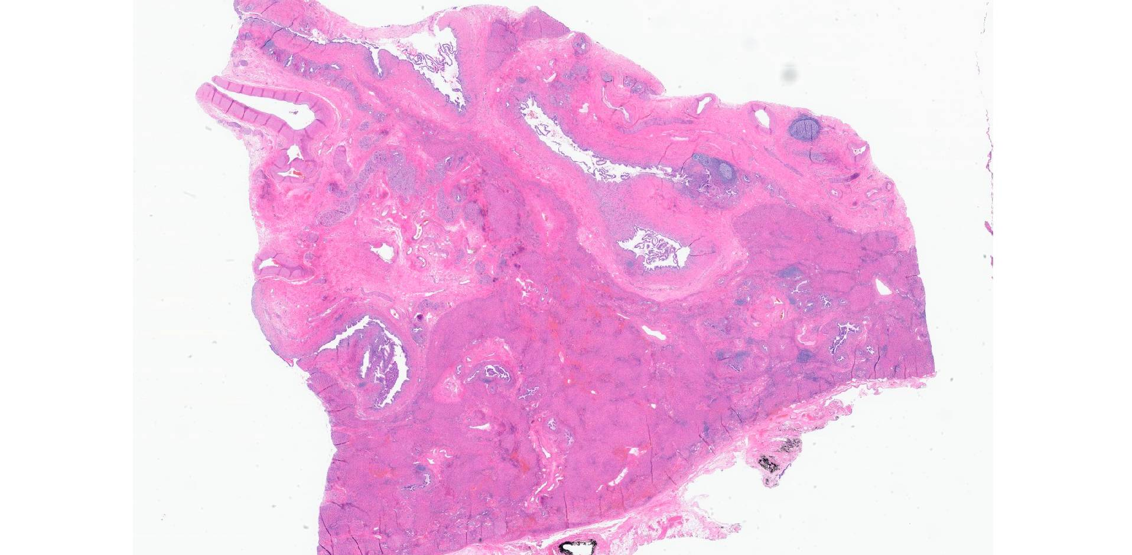

Slide 52
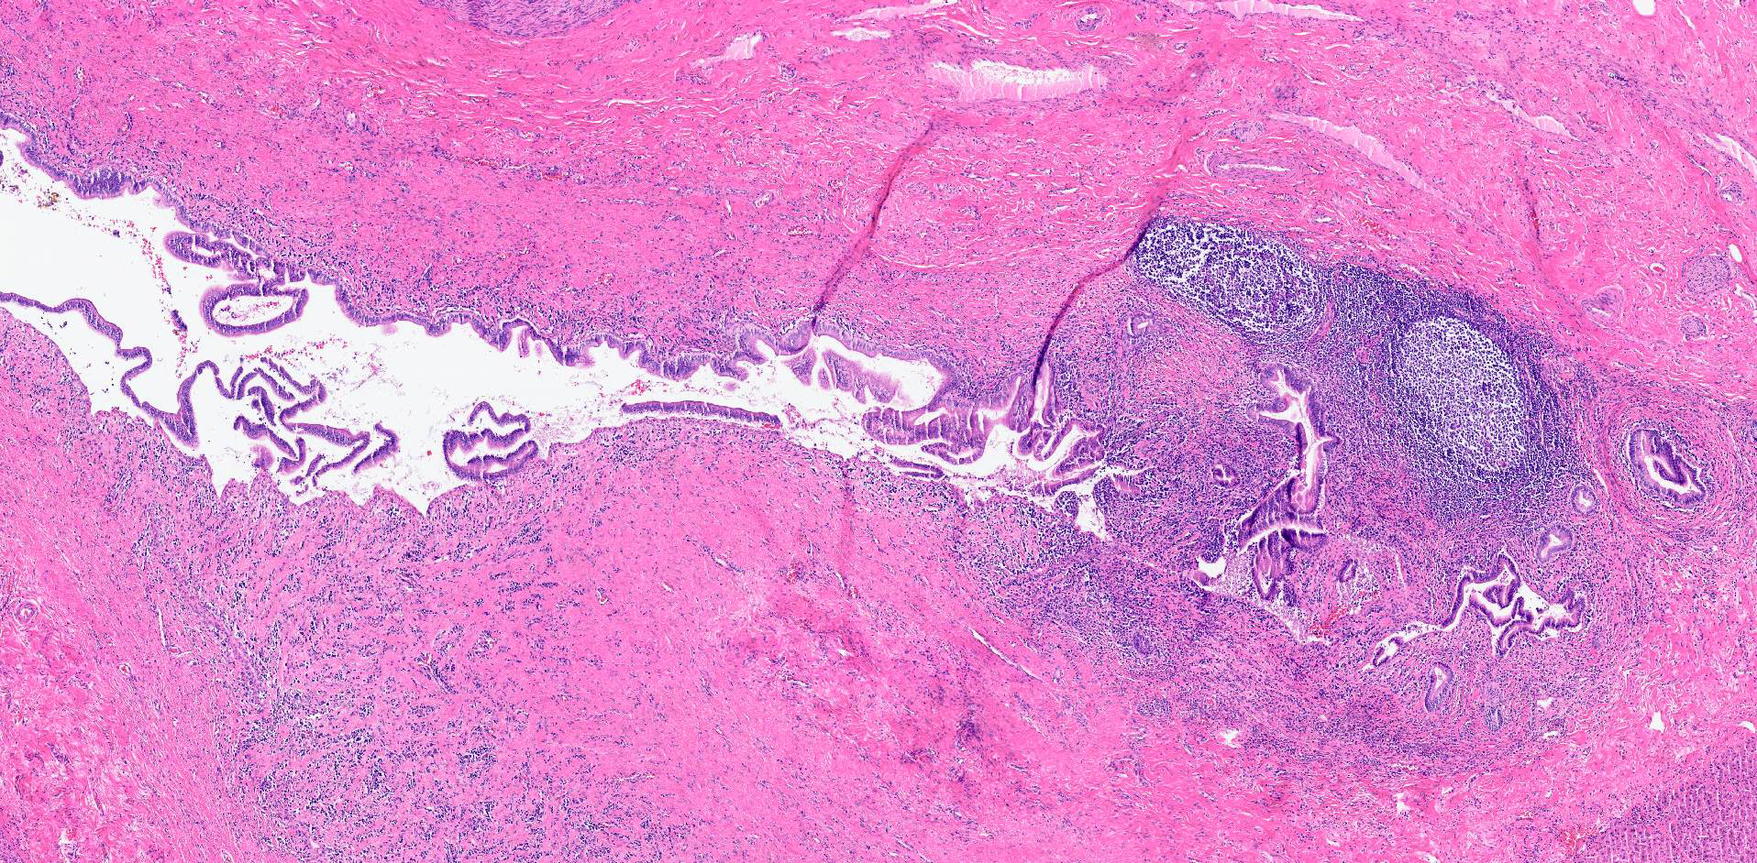

Slide 53
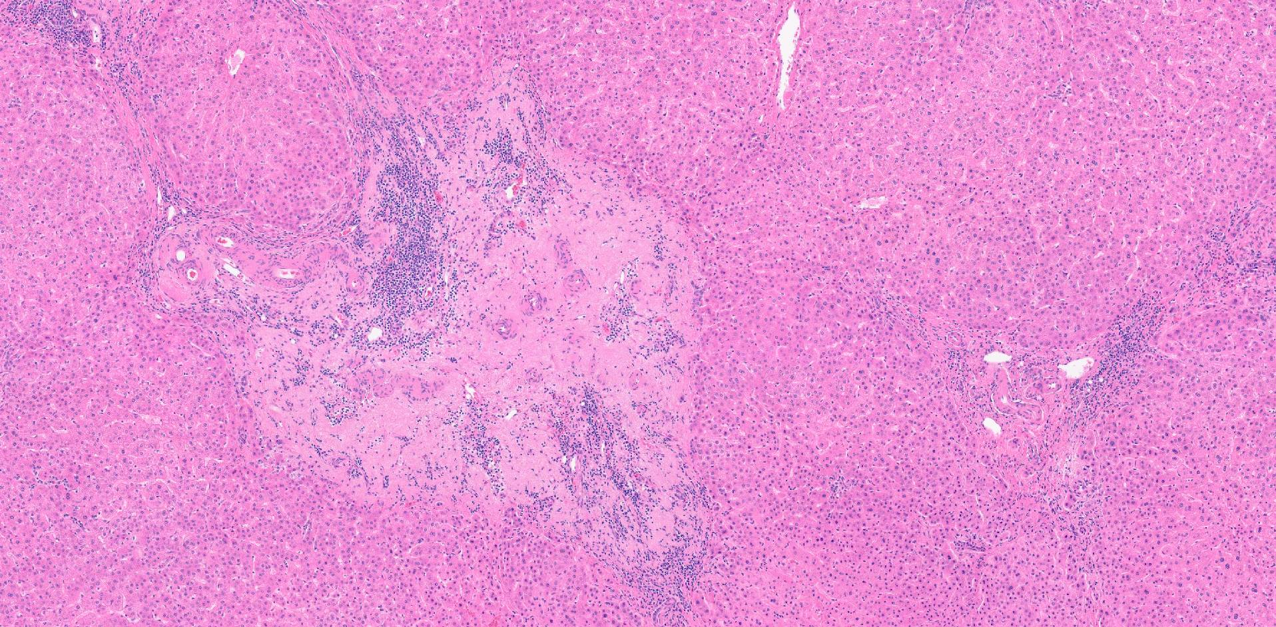

Slide 54
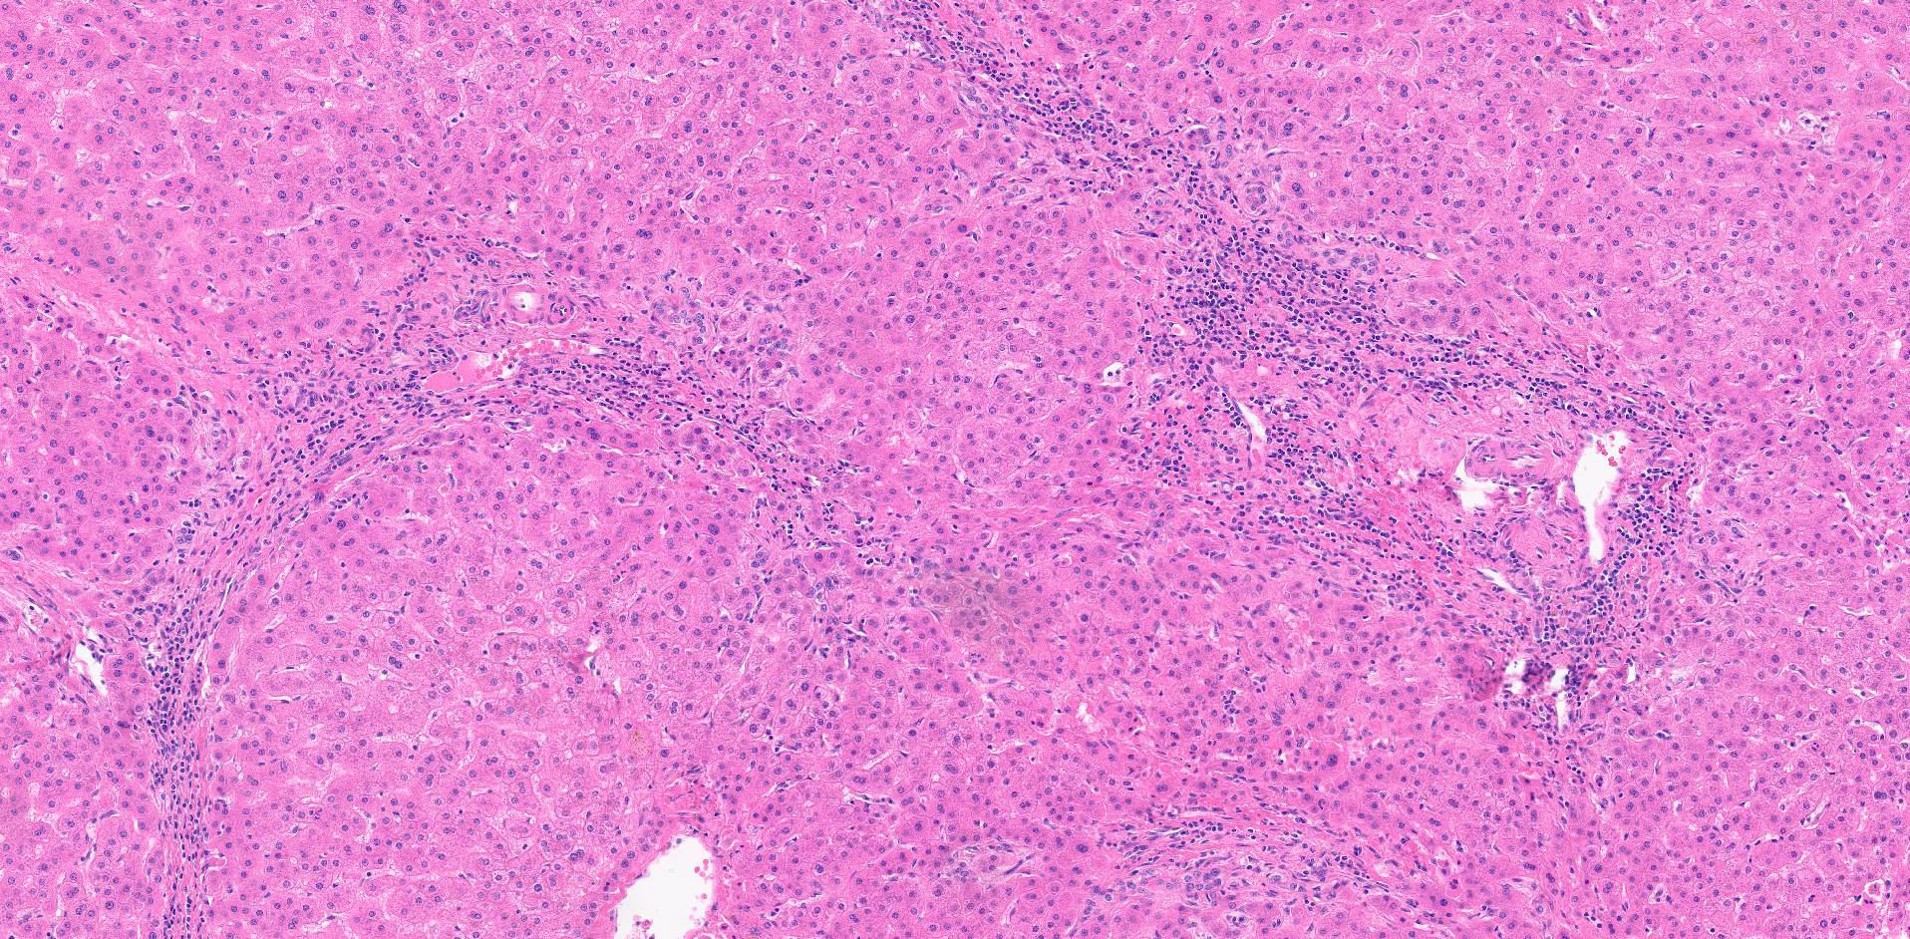

Slide 55
Expanding the Donor Pool
Use of living donors
Use of HCV positive donor organs
Use of steatotic donor organs
Use of donor organs harvested after circulatory death (DCD)
Use of ABO incompatible donor organs
Normothermic machine perfusion of donor organs

Slide 56
obrigado(A)!

Slide 57
